Slide 1
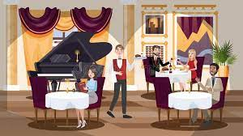
INFO-6150 Final Project
Bistro Hotel
Shriya Dikshith - 002921535
Sanket Khadke- 002968050
Shreya Gosrani - 002924191
Harshita - 002106349
Ayushi Patel- 002925618

Slide 2

Purpose :
When you move to a new city, people usually look for some easiest way to find stay and have fun. This application helps user to book rooms, lounges, halls and also order some food easily.
This application also allows you to request for a event hall and it can be approved by manager according to the availability.
This tool can also help you order multiple food items.
User can easily book a dining or bar table in a quickest way possible.

Slide 3
Features:
Login and Register functionality
CRUD operations on the hotel application
Search and Sort functionality for the lounge applications
Payment using paypal and stripe
View the hotel room bookings and the cuisine bookings
View the status of past orders
Authentication
Responsive UI design
User friendly and easy application

Slide 4

API’s Implemented:
Implement JWT (JSON Web Token) for authentication and authorization
Mongoose, MongoDB database in the cloud (Atlas)
Hash passwords using bcrypt
Axios for API calls
Email-js

Slide 5

Contributions
Sanket Khadke- Booking and orders screens and backend
Shriya Dikshith- Restaurants and rooms handling
Shreya Gosrani- Halls ,food products and admin roll
Ayushi Patel – Table booking
Harshita – Users and admin models

Slide 6
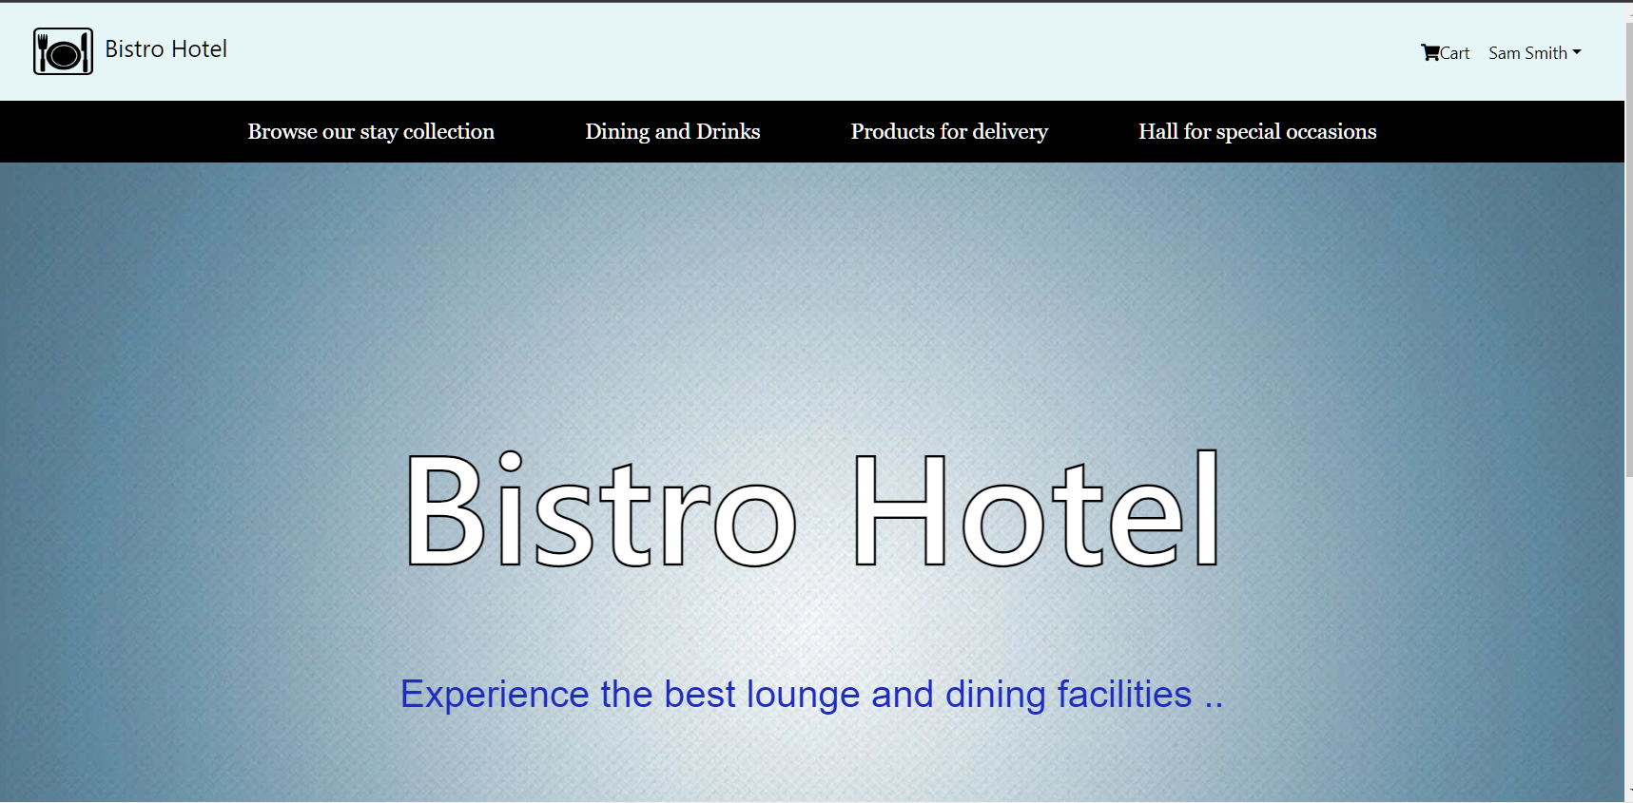
Landing Page

Slide 7
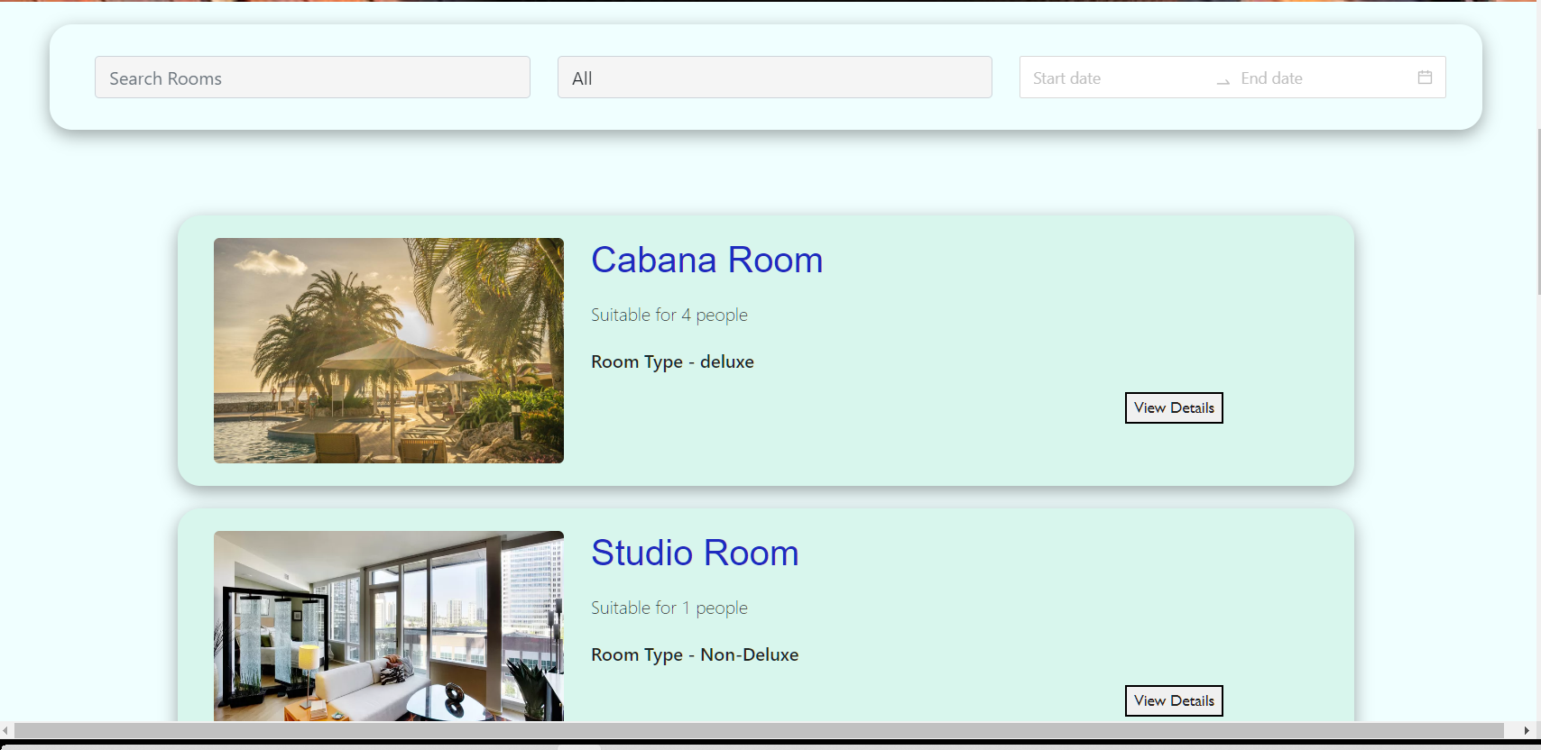
Room listings

Slide 8
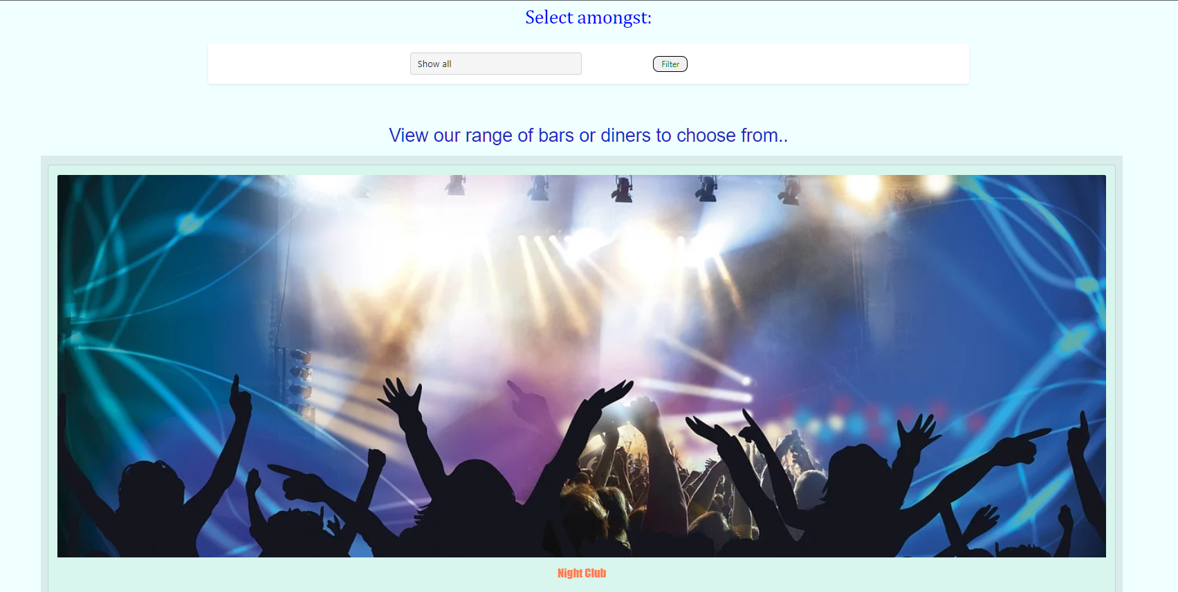
Dining location

Slide 9
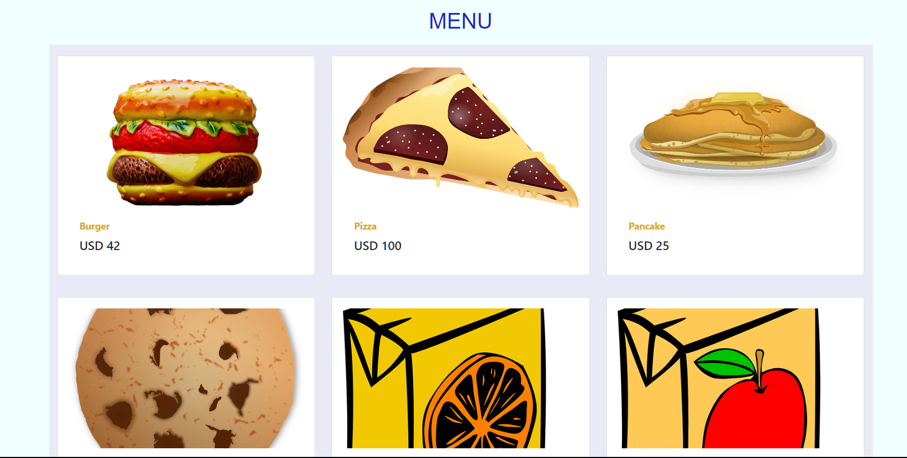
Food product list

Slide 10
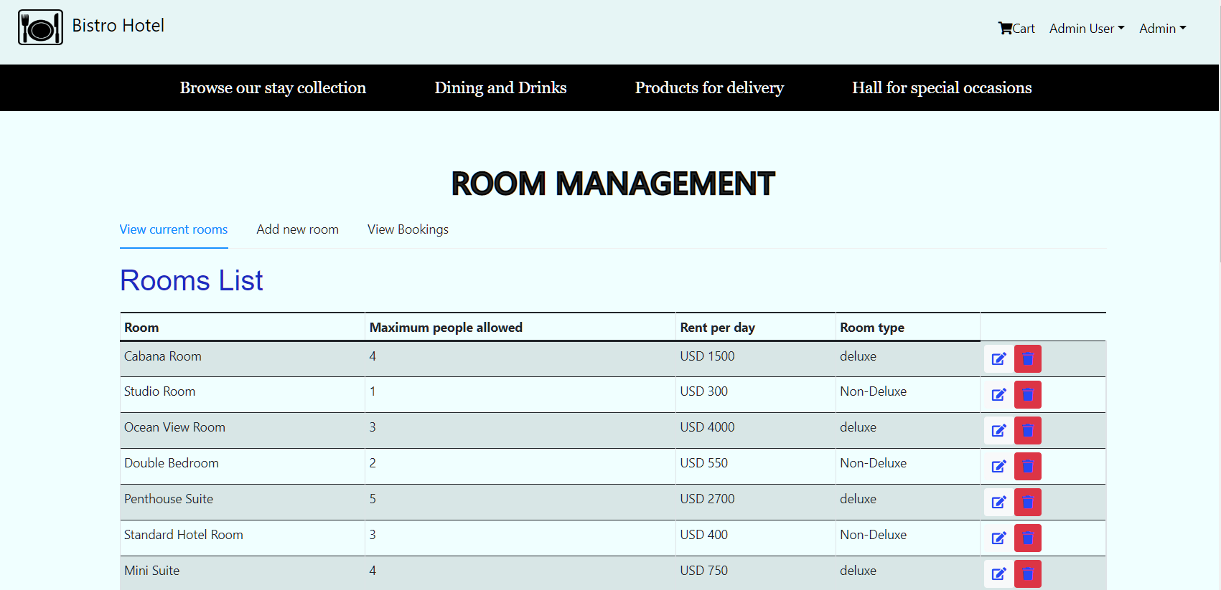
Admin room management

Slide 11
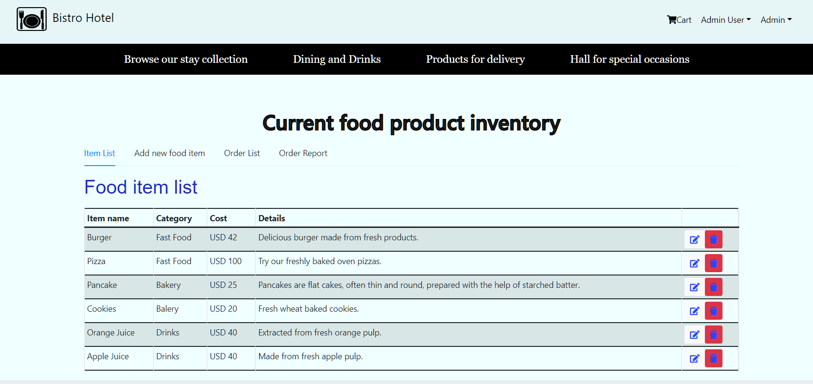
Admin Product Delivery

Slide 12
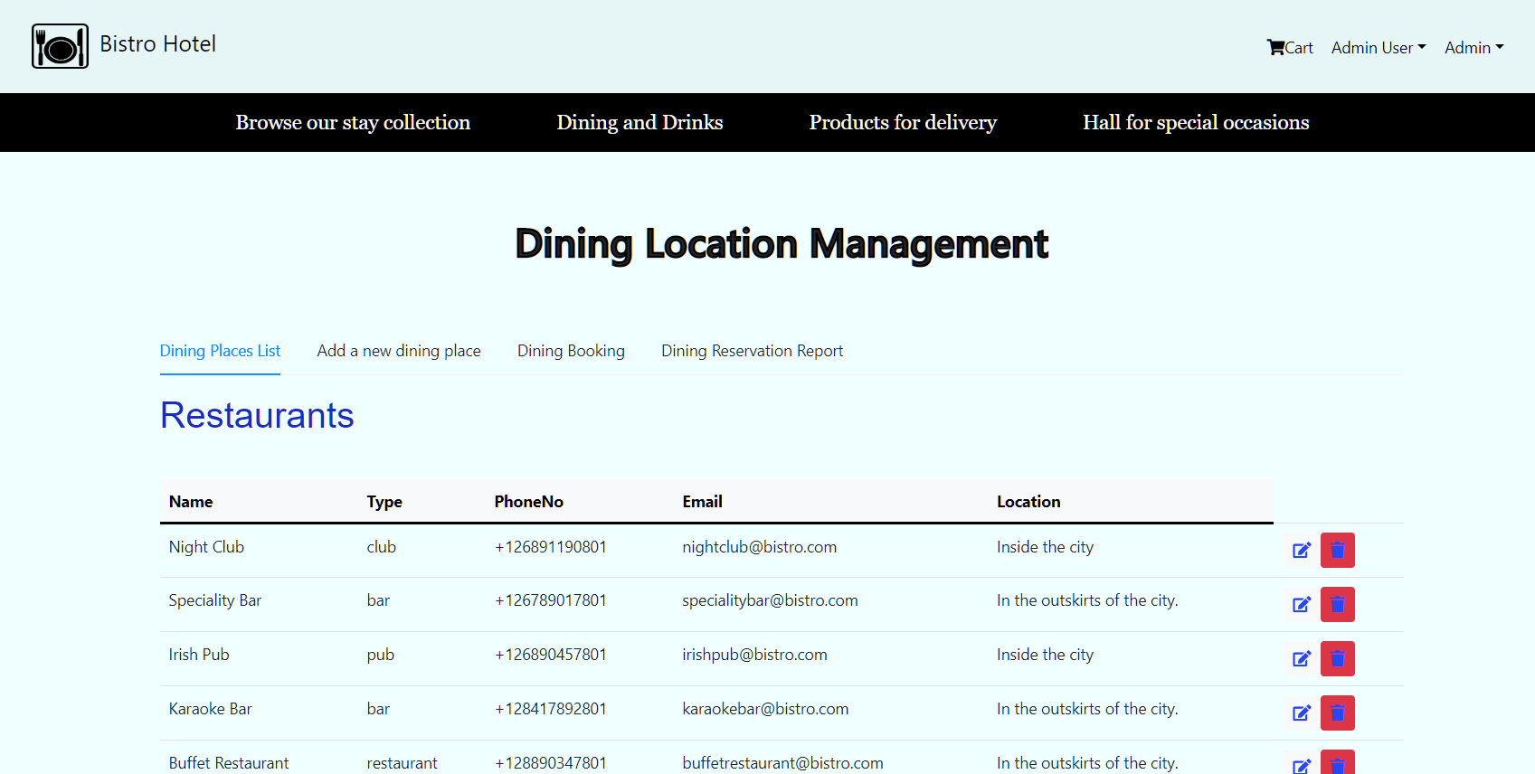
Admin dining management

Slide 13
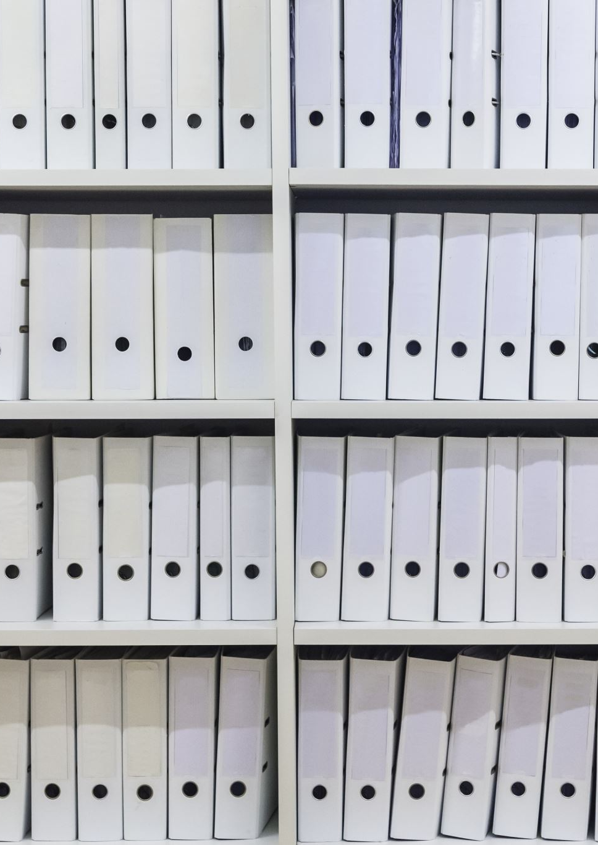
References
https://reactjs.org/
https://expressjs.com/
https://www.mongodb.com/
https://www.npmjs.com/
https://jwt.io/
https://www.npmjs.com/package/mongoose
https://developer.mozilla.org/en-US/

Slide 14

Thank you

